Slide 1
Decision Theory and Markov Decision Processes

Slide 2
Decision theory: Maximum expected utility
Suppose that an agent has to choose between different courses of actions. And suppose that the world is probabilistic (unlike, say, the peg problem) so that the outcome of an action is uncertain.
The basic tenet of decision theory is that to make the decision you should
Assign each possible outcome a numerical measure of how good it is, called its “utility”.
Let U_{A} be a random variable denoting the utility of the outcome if you execute action A. Then you should choose the action A that maximizes Exp(U_{A} ).

Slide 3
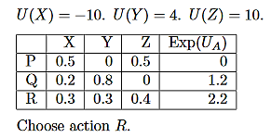
Maximum expected utility: Example
Suppose that you have three actions P, Q, R and three possible outcomes X, Y, Z.

Slide 4
Important: Don’t do probability matching!
If you are flipping a coin that comes up heads ¾ of the time and tails ¼ of the time, always bet on head.
Don’t bet on heads ¾ of the time and tails ¼ of the time.
If you flip the coin 100 times and you bet on heads each time, on average you will win about 75 times.
If you bet on heads 75 times and on tails 25 times, then on average you will win 56.25 of your bets on heads and 6.25 of your bets on tails, so a total of 62.5 bets.
(Probabilistic strategies are sometimes optimal in playing against an adversary who is trying to guess what you will do, but not in playing against the universe.)

Slide 5
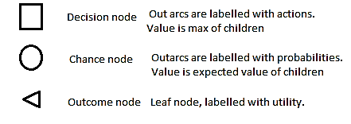
Decision trees
When you have a sequence of actions to carry out, and the choice of later steps depends on information gathered on the way, then this can often be represented by a decision tree.
Three types of nodes.

Slide 6
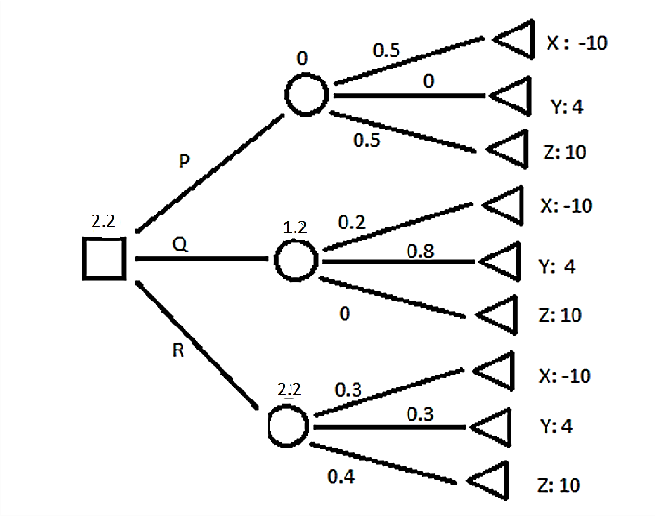
Example decision tree

Slide 7
Decision tree: Restaurant example
Two resturants: Indian 5 minutes walk north; Chinese 10 minutes south.
Chinese restaurant is busy with probability 0.5; Indian with probability 0.8.
At both:
If the restaurant is quiet, then lunch will take 10 minutes
If it is busy then with probability 0.25 lunch will take 30 minutes and with probability 0.75 it will take 60 minutes.

Slide 8
4 Plans
Go to Indian restaurant and stay. Expected time: 0.2∙20 + 0.8 ∙ 0.25 ∙ 40 + 0.8 ∙ 0.75 ∙ 70= 54
Go to Indian restaurant. If quiet, stay; if busy, go to Chinese restaurant. Expected time: 0.2∙20 + 0.8 ∙ 0.5 ∙ 40 + 0.8 ∙ 0.5 ∙ 0.25 ∙ 60 + 0.8 ∙ 0.5 ∙ 0.25 ∙ 90=53
Go to Chinese restaurant and stay. Expected time: 0.5∙30 + 0.5 ∙ 0.25 ∙ 50 + 0.5 ∙ 0.75 ∙ 80= 51.25
Go to Chinese restaurant. If quiet, stay; if busy, go to Indian restaurant. Expected time: 0.5∙30 + 0.5 ∙ 0.2 ∙ 40 + 0.5 ∙ 0.8 ∙ 0.25 ∙ 60 + 0.5 ∙ 0.8 ∙ 0.25 ∙ 90=52

Slide 9
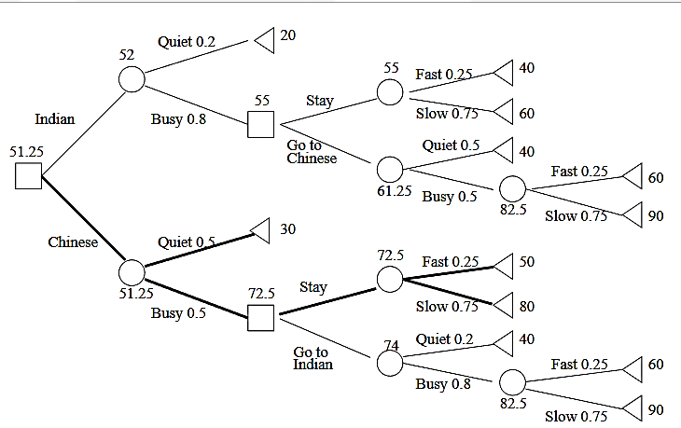
Decision Tree

Slide 10
Decision tree: Publisher example
A publisher receives a manuscript.
If he publishes and it is a success, he will make $50,000.
If he publishes and it fails, he will lose $10,000.
The probability of success is 0.2.
Or he can consult with a reviewer, who charges $500.
If the book would be a success, the reviewer will approve with probability 0.7
If the book would be a failure, the reviewer will approve with probability 0.4.

Slide 11
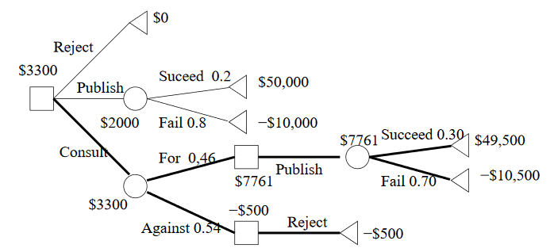
Decision tree: Publisher example

Slide 12
Conditional probabilities in the Reviewer example
P(For) = P(For,Succeed) + P(For,Fail)
P(For|Succeed)*P(Succeed) + P(For|Fail)*P(Fail) =
0.7*0.2 + 0.4*0.8 = 0.46
P(Against) = 1−P(For) = 0.54
P(Succeed|For) = P(For|Succeed)*P(Succeed)/P(For) = 0.14/0.46=0.3
P(Fail|For) = 1 − P(Succeed|For)=0.7

Slide 13
Value of information
The expected increase in outcome if a given piece of information is free.
For the reviewer example, the reviewer’s opinion is worth $1800.
(If the reviewer’s opinion were free, then the expected profit is $3800 as compared to $2000 without it.)
Information never has negative value.
If the reviewer is useless then you can ignore them.
If the reviewer is worse then useless (predictions are reliably wrong) then you can do the opposite.

Slide 14
Markov Decision Problem (Simple version)
Generalize a tree state space to a graph.
There is a finite collection of states.
Some of these are terminal states. A terminal state has a reward, and the process ends when a terminal state is reached.
In each non-terminal state, there are a number of possible actions. For each state S and action A, there is a probability distribution over the next state attained if you execute action A in state S.
A policy is a choice of action at each state. The problem is to find the policy that optimizes your expected final reward.

Slide 15
Markov property
When you performing action A in state S, the probability of the next state depends only on A and S, not on anything that happened before S.
Andrey Andreyevich Markov (1856-1922)

Slide 16
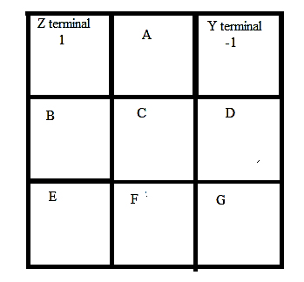
MDP: Example
In any state: You can attempt to move in any of the cardinal directions that has a square in it.
With probability 0.8 you will succeed in moving where you are going.
If there are q other neighboring squares, with probability 0.2/q you will end up in one of those.

Slide 17
MDP: Example
For instance:
If you are in state C and you try to move up, with probability 0.8 you will end in A and with probabilities 0.067 you will end in B, F, or D.
If you are in A and you try to move right, then with probability 0.8 you will end in Z and with probabilities 0.1 you will end in Y or C.

Slide 18
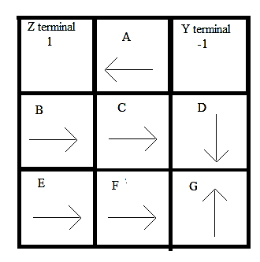
Computing values given a policy
(Using state name for its expected value under this policy.)
Z=1. Y = −1.
A=0.8Z + 0.1C + 0.1Y
B=0.8C + 0.1Z + 0.1E
C=0.8D + 0.067A + 0.067B + 0.067F
etc.
Solution: A=.63, B=−.56, C= −.73, D=−.844 E=−.77, F= − 0.82, G=−.8395

Slide 19
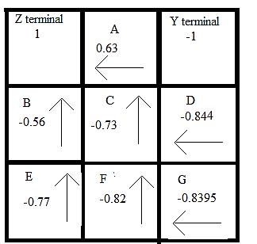
Find best policy given the values
In each state, find the action with maximal expected value. (In this case, that is trying to get to the highest valued state.)

Slide 20
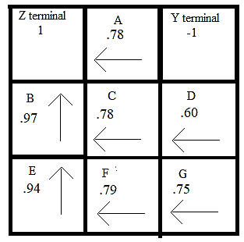
Recalculate the values given the new policy. Iterate.
Z=1. Y = −1.
A=0.8Z + 0.1C + 0.1Y
B=0.8C + 0.1Z + 0.1E
C=0.8D + 0.067A + 0.067D + 0.067F
etc.
Solution: A=.78, B=.97, C=.78, D=.60, E=0.94, F=0.79, G=0.75

Slide 21
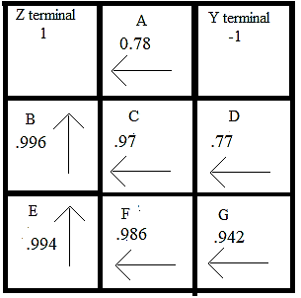
Iterate. Policy is unchanged. Terminate.
Solution:
A=.78, B=.996, C=.97,
D=.77,E=.994,F=.986, G=.94

Slide 22
How to solve the MDP
For any particular policy φ and state S, let V_{φ} (S) be the expected reward if you start in S and play according to φ.
Let π be the optimal policy. Thus π(S) is the best action to execute in S.
Let ν(S) = V_{π} (S) be the true expected value of state S if you execute the optimal policy π

Slide 23

Calculating V_{φ} from policy φ
For a terminal state S, V_{φ} (S) is the reward at S.
For any particular policy φ and non-terminal state S, V_{φ}(S) is the expected value of V_{φ}(S’) if you execute φ(S) in S.
That seems circular, but it’s actually just a set of simultaneous linear equations in the variables V_{φ} (S).
In particular

Slide 24

Calculating the optimal policy from ν(S)
If you knew the value of ν(S) for all states S, then the optimal action A to execute in state U would be the one that has the highest expected value of ν(S’) if you execute A.
This and the previous equation are known as the Bellman-Ford equations.

Slide 25
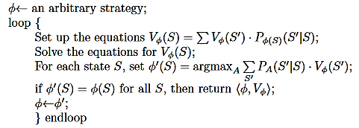
Conceptually simple algorithm for MDPs

Slide 26
Algorithm design
This type of algorithm is one we’ll see a number of times going forward. It’s sometimes called an “EM-type” algorithm.
Broadly speaking, you have a state that consists of two parts --- here the policy and the values. You want to optimize the overall state, but you don’t know how to do that directly. So you hold part A fixed and optimize or solve part B for that value of A; and then you fix part B and then optimize part A for that value of B. Iterate until things converge.
Slosh back and forth.

Slide 27
Features of MDP algorithm
It terminates. Proof:
A. You can show that at every iteration, no state ever decreases its value, and some state increases its value. So it is a hill-climbing algorithm, and can’t go into a loop.
B. There are only finitely many policies. In practice it generally terminates quickly.
It finds the actual optimal solution. This is rare for this type of algorithm, but true in this case.

Slide 28
More efficient computationally
Solving a set of simultaneous linear equations is computationally burdensome. And it’s largely a waste of time, since all you’re doing is seeing which action is best in each state. Once you go to a new policy, you have a new set of equations and you throw out all the old values.

Slide 29
More efficient computationally
Easy approximation to solving the equations: Treat the equations as assignments. Compute all the new values from the old values, then replace.
Still guaranteed to converge to the right answer. Downside is that the termination condition becomes harder.
A’ ← 0.8Z + 0.1C + 0.1Y
B’ ← 0.8C + 0.1Z + 0.1E
C’ ← 0.8D + 0.067A + 0.067D + 0.067F
…
A ← A’
B ← B’
C ← C’

